Slide 1
Alamogordo Desalination Project
NM Water Leaders Summit 2026
Robert A. Fowlie, PE, BCEE Vice President Jacobs Engineering

Slide 2
Project History
2003 - Desalination feasibility study prepared in response to drought of 1999-2003.
2003 - City submits application to NMOSE for water rights in Tularosa Basin.
2004 - Received NMOSE approval. Decision appealed and made its way through court system. Final approval in 2010.
2012 - Required EIS prepared by BLM was approved.
2012 - Little Bear Fire and loss of Bonito Lake.
2014 - Design started
2016 – Design completed
2017 to 2019 - Construction of 1 MGD Desalination Plant.

Slide 3
Need for Project
70% of City water supply is surface water (Bonito Lake and Springs in Sacramento Mtns east of the City)
30% of supply is groundwater wells (groundwater is slightly brackish and is blended with surface water before being supplied to distribution system)
Need for project defined by AWWA M50 Manual of Water Supply Practice concept of firm yield/supply.
Firm yield/supply is “reliable withdrawal rate of acceptable quality water that can be supplied by available flows and/or storage releases from reservoirs and/or ground water reserves throughout a critical drought period”

Slide 4
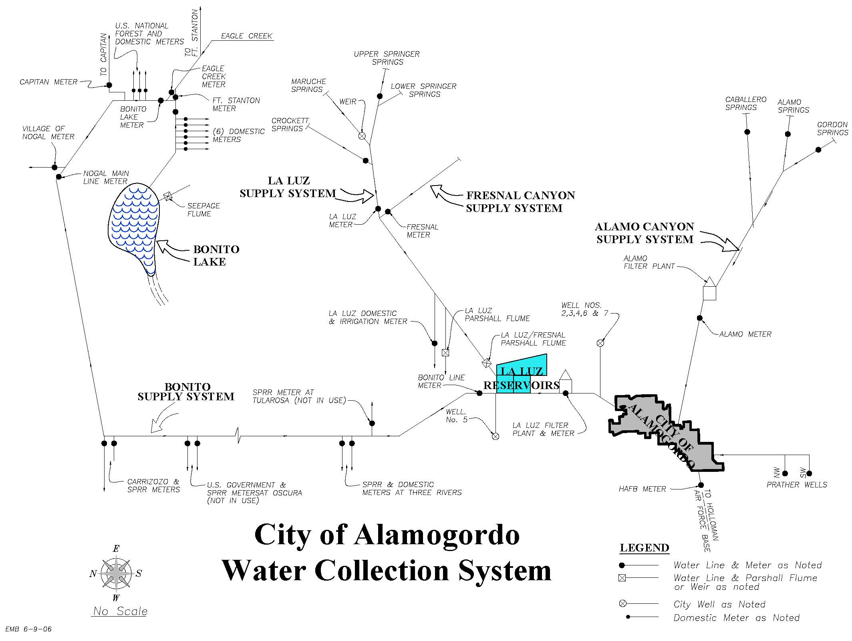

Slide 5
Water Quality

Slide 6
Brackish Groundwater Treatment Plant – Infrastructure
Snake Tank Well and 25-mile pipeline
Capacity – 1 MGD (2- 0.5 MGD Skids)
Design recovery -70% (80 is more realistic)
Bypass 30% of raw water for blending
Finished water TDS – 800 mg/L
No feed pumps – process uses 300’ elevation difference between Snake Tank well and treatment plant.
Finished water clearwell and booster station
Concentrate TDS – 8,000 mg/L

Slide 7
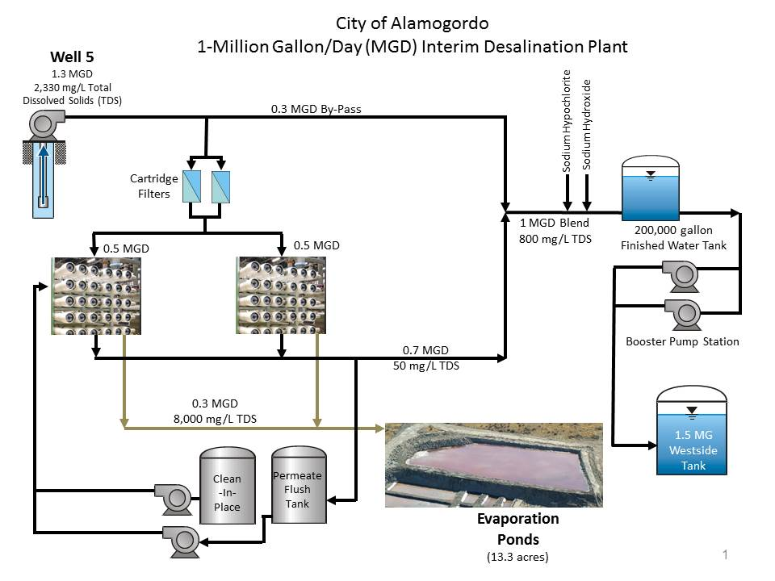

Slide 8
Concentrate Disposal
Concentrate disposal to sanitary sewer and 5.6 acre evaporation pond.
Plant operator controls how much goes to pond and sanitary sewer (60-65% goes to sanitary sewer).
Pond is double lined (2-60 mil HDPE liners separated by geonet).
Future expansions in production capacity will require injection well for concentrate disposal.

Slide 9
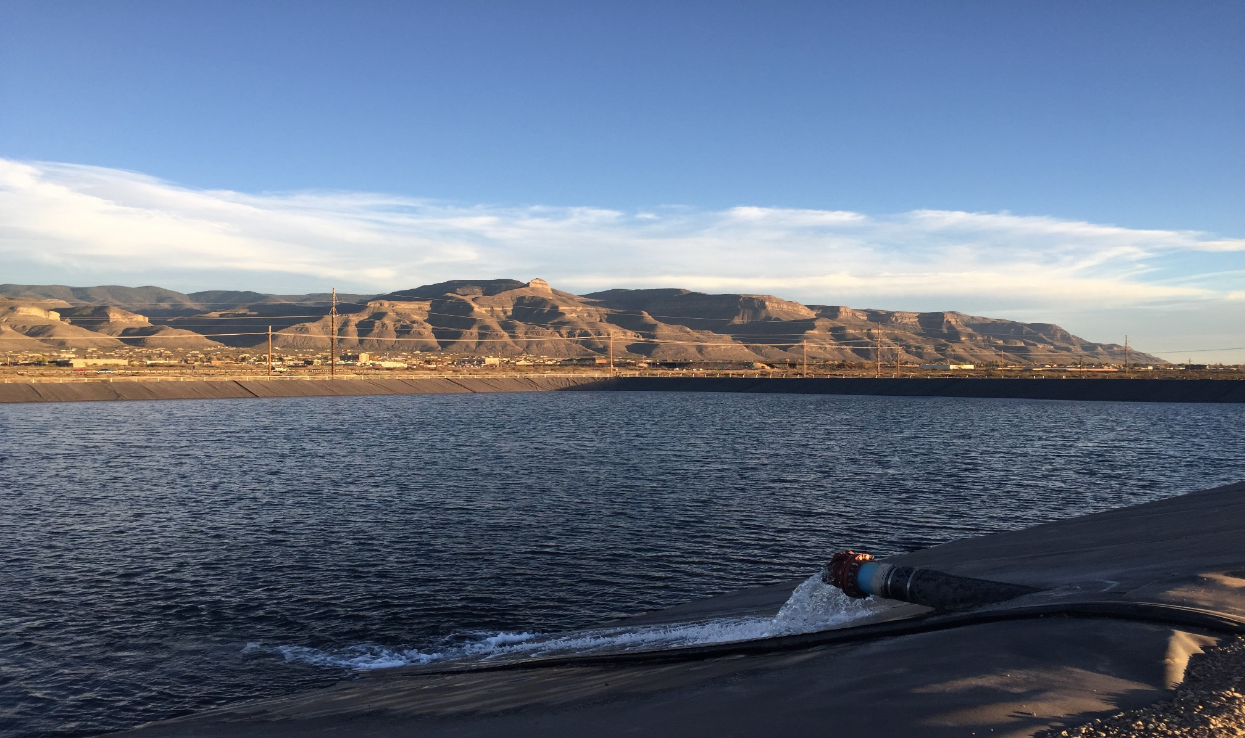
Evaporation Pond

Slide 10
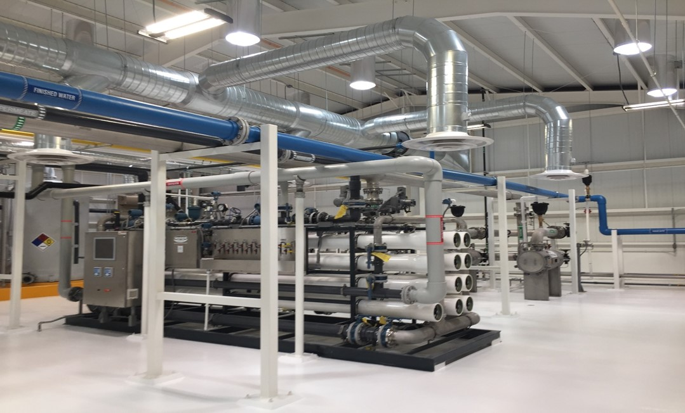
Treatment Plant RO Skids

Slide 11
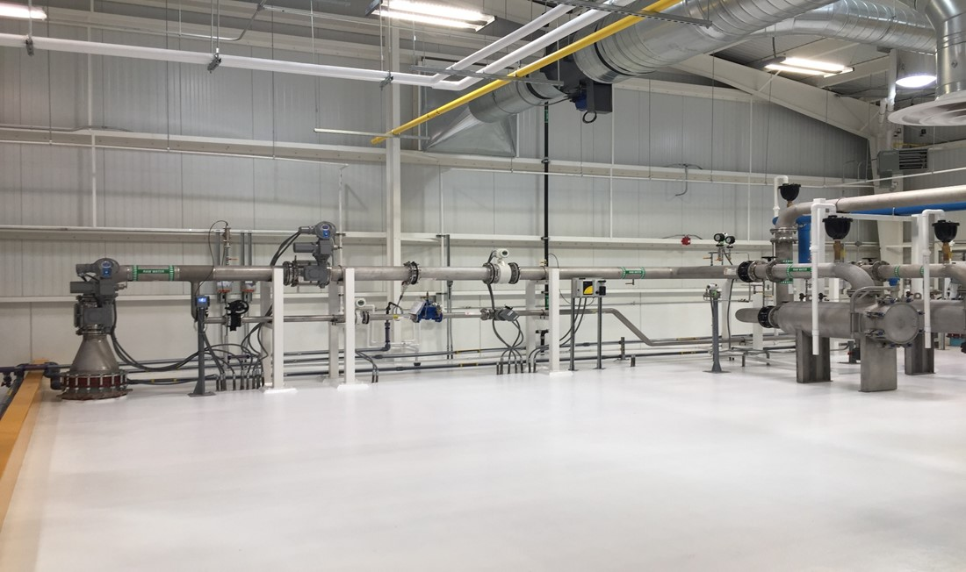
Process Piping

